Slide 1
Soft computing part 3
Arnaldo Sepulveda

Slide 2
Genetic Fuzzy Systems
This method makes use of genetic algorithm for determining the system parameters such as fuzzy rule base, membership functions.
The goal for this method is the optimization or search process of the fuzzy system parameters.
Decide which part of knowledge base to be optimized by the GA

Slide 3
Membership function encoding

Slide 4
Base rule function encoding

Slide 5
Neuro-Fuzzy Systems
This method makes use of neural networks for determining the system parameters such as fuzzy rule base, membership functions.
The goal for this method is the learning process of the fuzzy system parameters.
Decide which part of knowledge base to be optimized by the neural network

Slide 6
Neurons structure

Slide 7
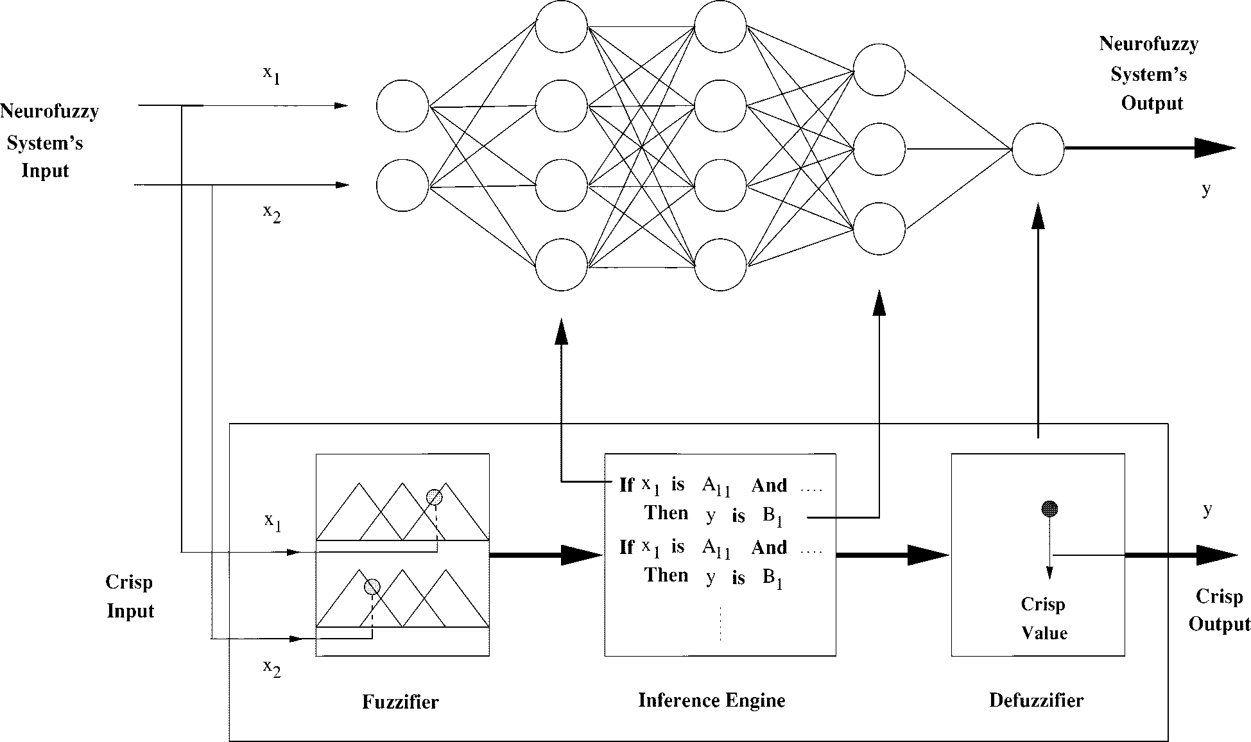
Neuro Fuzzy Controller

Slide 8
Neuro-Fuzzy Structure
DRNFS consist of four layers in which each neuron provide an operation function
DRNFS model uses an hybrid learning algorithm to adjust the membership functions
of the FLC in the second layer of the NFS and the fuzzy rules of the FLC by adjusting the weights between the third and fourth layer of the NFS

Slide 9
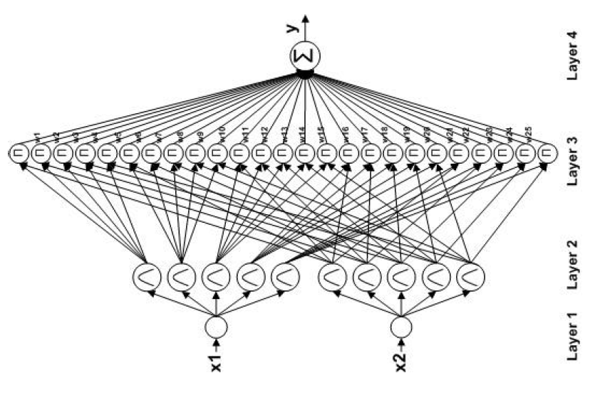
Neuro-Fuzzy Structure

Slide 10
Neuro-Fuzzy Structure
Layer 1 (input node): each node represents one input linguistic variable
Layer 2 (fuzzication): acts as a membership function of the inputs
Layer 3 (fuzzy rule base): each neuron perform an AND operation of the inputs
Layer 4 (output node): combines output of layer 3 with the associated weights “wi” which are located between layer 3 and 4

Slide 11
Layer 1
For this layer each input transfer the numerical value received to layer 2. Each output ith on this layer is

Slide 12
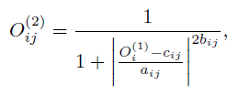
Layer 2
Each neuron in this layer perform a membership function. The bell shape membership function, defined from 0 to 1, is used on this layer as

Slide 13
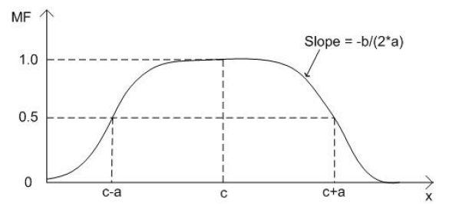
Membership function
Parameters a; b and c of membership function equation for layer 2:

Slide 14
Layer 3
The product operation is performed in this layer, that represents the firing strength of its equivalent rule

Slide 15
Layer 4
The single node in this layer is a fixed node which performs the defuzzication operation as the summation of all incoming signals as

Slide 16
Learning Algorithm of Neuro-Fuzzy
The optimization of the DRNFS is performed in this section through supervised training of the parameters of the membership function a, b and c, and the output action strength w
In the forward pass the algorithm uses least-squares method to identify the consequent parameters on the layer 4 and in the backward pass the errors are propagated backward and the premise parameters are updated by gradient descent approach

Slide 17
Learning Algorithm of Neuro-Fuzzy
The goal of the learning scheme is to minimize the error function defined as shown below
Where dj(t + 1) is the desired output and yj(t + 1) is the actual output of the DRNFS

Slide 18
Layer 4
The parameters Nw, Na, Nb and Nc are the learning rates of the membership function a, b and c, and the output action strength w
In this layer the error term is computed and propagated as

Slide 19
Layer 3
In this layer the error term is computed and propagated as

Slide 20
Layer 2
In this layer the error term is computed and propagated as

Slide 21
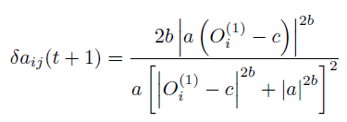
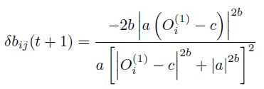
The change on the membership function parameters a, b and c are calculated as

Slide 22
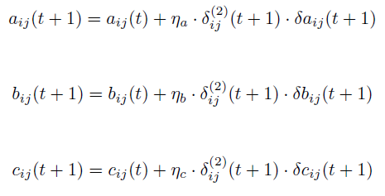
The update of the membership function parameters are performed as

Slide 23
Learning Algorithm of Neuro-Fuzzy

Slide 24
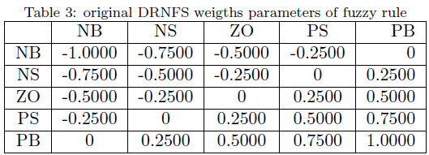
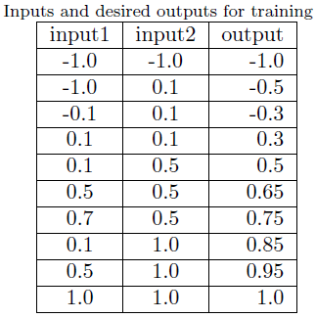
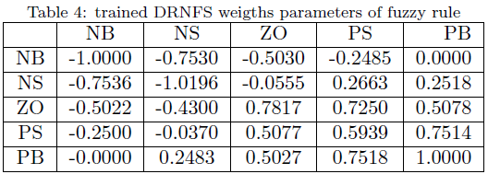
Example for water heater control

Slide 25
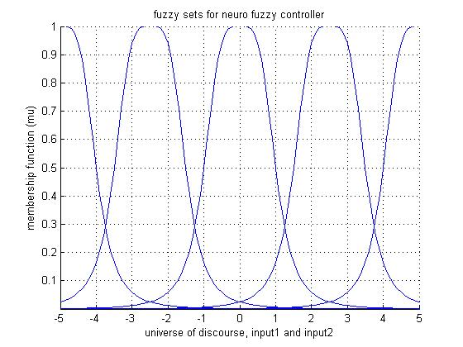
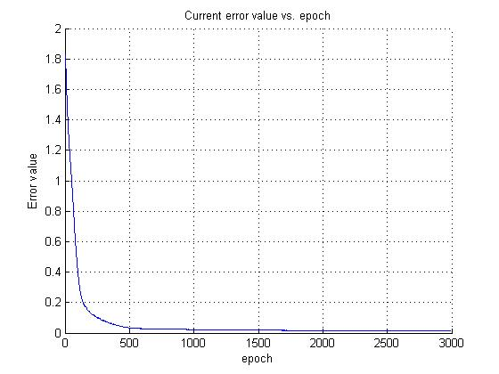
Original membership function and neural network training

Slide 26
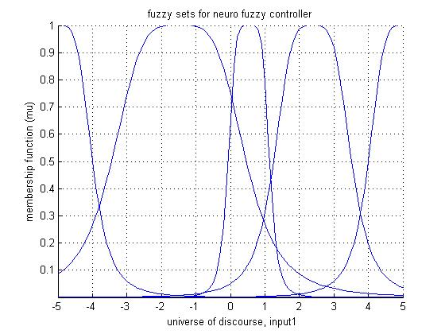
Resulting membership function after training

Slide 27
Questions

